Slide 1
Geometric Analysis of Shark Teeth

Slide 2
Math & Nature
The universe is written in the language of mathematics
Galileo Galilei, 1623
Quantitative analysis of natural phenomena is at the heart of scientific inquiry
Nature provides a tangible context for mathematics instruction

Slide 3
The Importance of Context
Context
The part of a text or statement that surrounds a particular word or passage and determines its meaning.
The circumstances in which an event occurs; a setting.

Slide 4
The Importance of Context
Context-Specific Learning
Facilitates experiential and associative learning
Demonstration, activation, application, task-centered, and integration principles (Merrill 2002)
Facilitates generalization of principles to other contexts

Slide 5
Math & Nature
Geometry & Biology
Biological structures vary greatly in geometry and therefore represent a platform for geometric education
Geometric variability → functional variability
Mechanism for illustrating the consequences of geometry

Slide 6
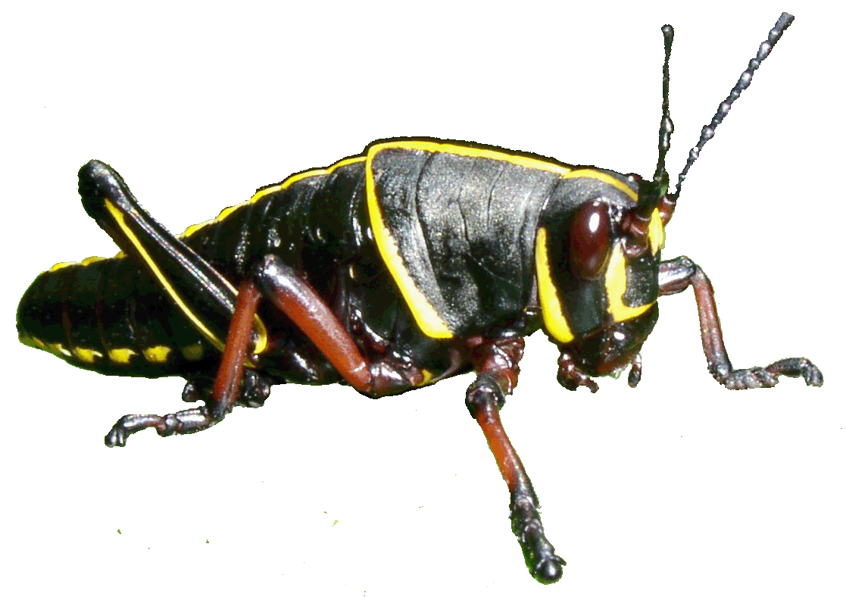
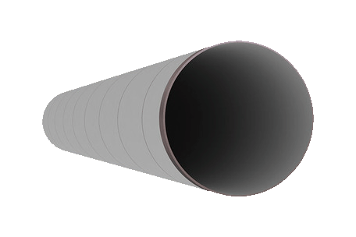
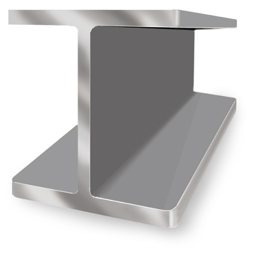
Math & Nature
Geometry & Biology
Geometric variability → functional variability
Mechanism for illustrating the consequences of geometry

Slide 7
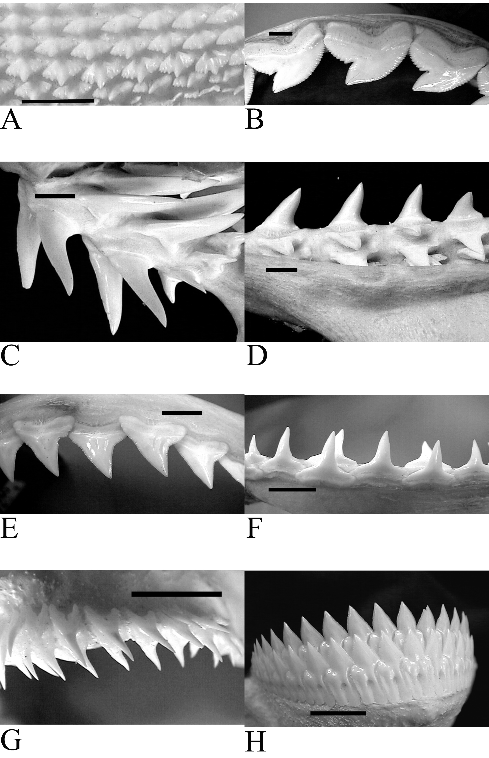
Math & Nature
Geometry & Biology
Shark teeth as a case study in geometric variability
Shape determines cutting performance
Cutting performance determines feeding ecology
Motta & Huber (2012)

Slide 8
Math & Nature
Geometry & Biology
Geometry Objectives
MA.912.G.7.5 – Explain and use formulas for lateral area, surface area, and volume of solids
MA.912.G.4.4 – Use properties of congruent and similar triangles to solve problems involving lengths and areas
MA.912.G.1.3 – Identify and use the relationships between special pairs of angles formed by parallel lines and transversals

Slide 9
Math & Nature
Geometry & Biology
Biology Objectives
SC.912.N.1.1 – Define a problem based on a specific body of knowledge and do the following:
Pose questions about the natural world
Plan investigations
Use tools to gather, analyze, and interpret data
Pose answers, explanations, or descriptions of events
Generate explanations that describe natural phenomena
Use appropriate evidence and reasoning to justify these explanations to others

Slide 10
Math & Nature
Geometry & Biology
Biology Objectives
SC.912.L.15.1 – Explain how the scientific theory of evolution is supported by the fossil record, comparative anatomy, comparative embryology, biogeography, molecular biology, and observed evolutionary change.

Slide 11
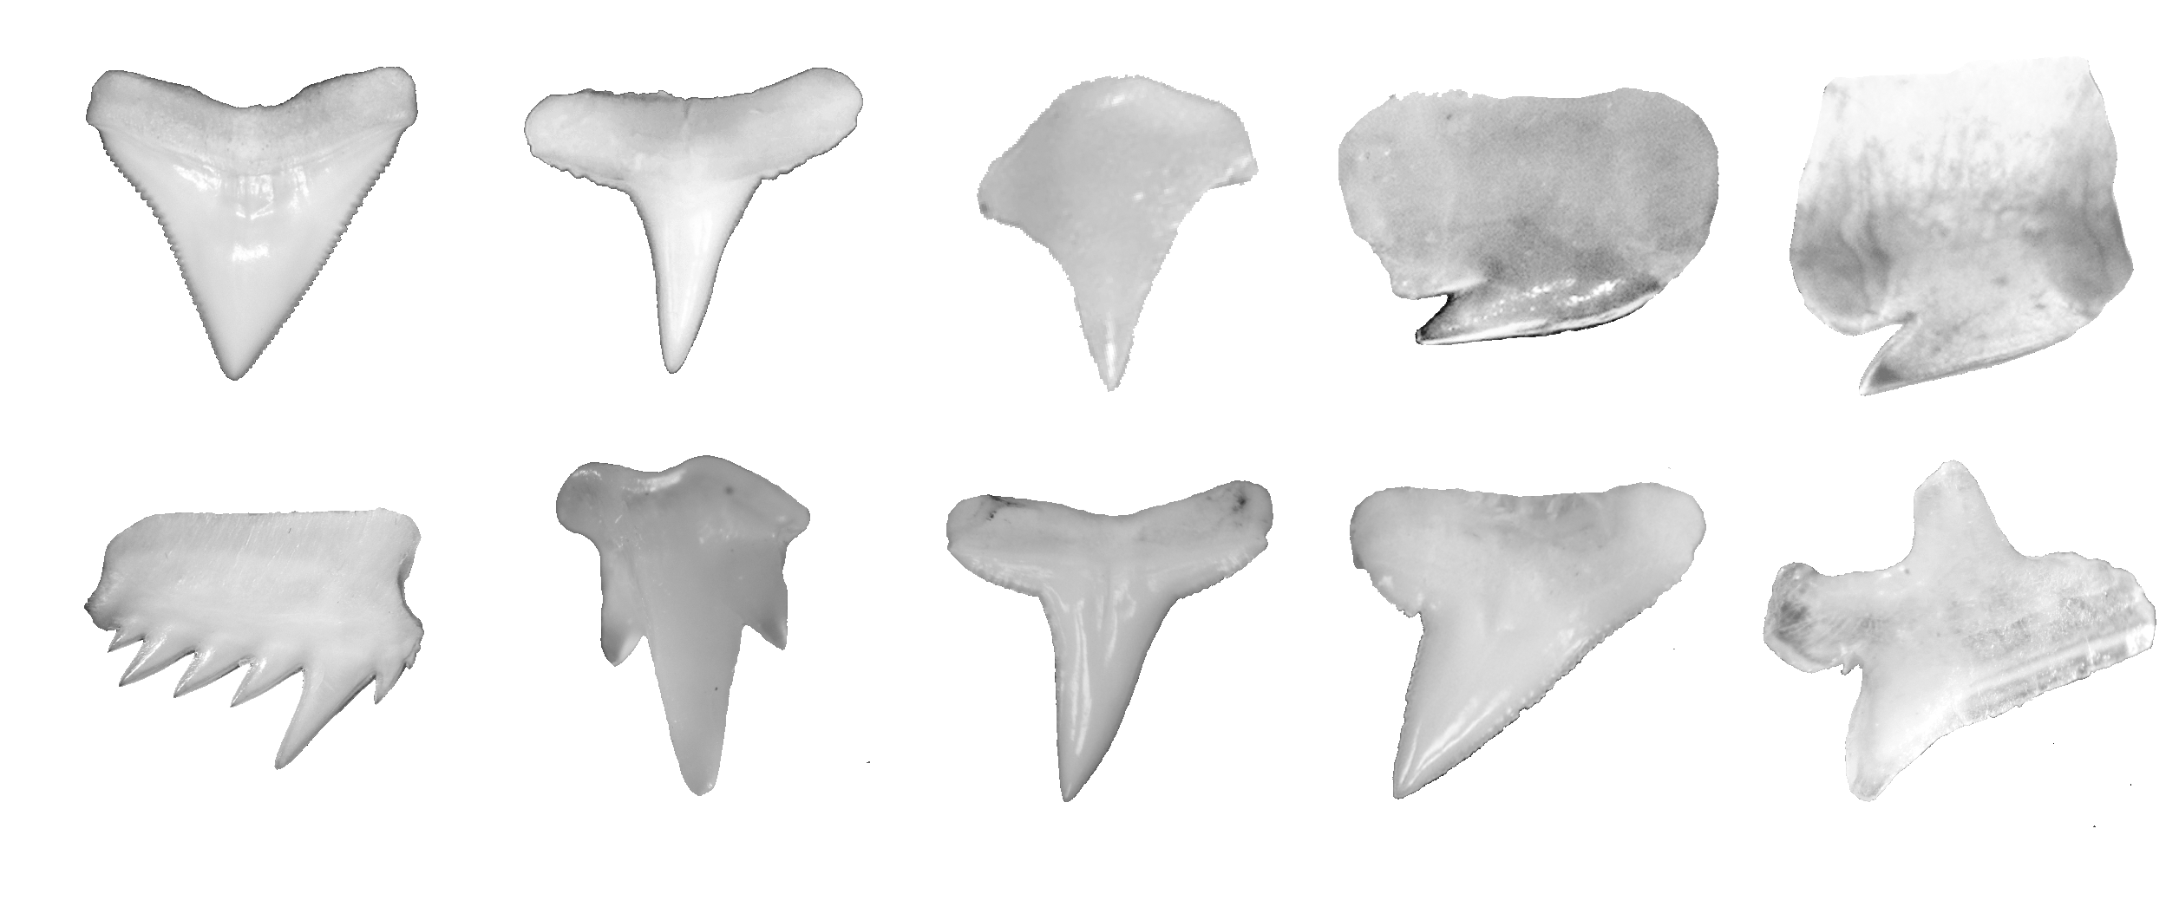
Math & Nature
Shark teeth
Heterogeneity among species
© D.Huber (2012)

Slide 12
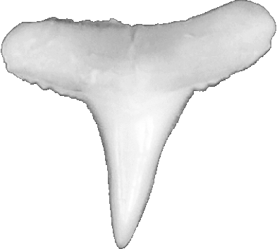
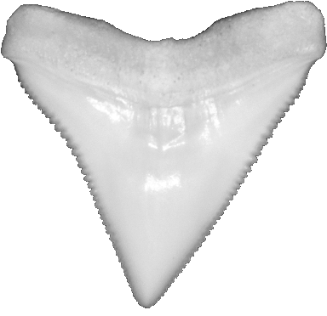
Math & Nature
Shark teeth
Heterogeneity among species
Interaction of behavior and geometry
Insert or play Shredder video here
© D.Huber (2012)

Slide 13
Math & Nature
Shark teeth
Heterogeneity among species
Interaction of behavior and geometry
Questions:
Which tooth is better for puncture?
Which tooth is better for lateral head-shaking?

Slide 14
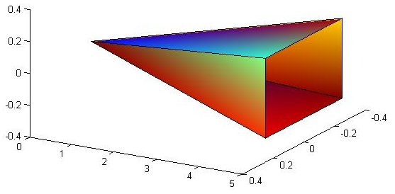
Math & Nature
Shark teeth
Which tooth is better for puncture?
Greater pressure = greater puncture
$Tooth Pressure=\frac{Bite Force}{Lateral Surface Area}$
Model tooth as right square pyramid

Slide 15
Math & Nature
Shark teeth
Which tooth is better for puncture?
Blacktip shark tooth
Altitude = 5
Base = 0.5
Bull shark tooth
Altitude = 4
Base = 2
© D.Huber (2012)

Slide 16
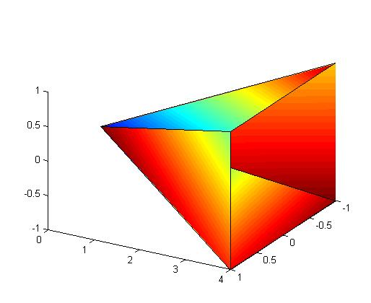
Math & Nature
Shark teeth
Which tooth is better for puncture?
Blacktip shark tooth
Altitude = 5
Base = 0.5
Bull shark tooth
Altitude = 4
Base = 2

Slide 17
Math & Nature
Shark teeth
Which tooth is better for puncture?
Compute lateral surface area of each tooth at:
1/10 the length of the altitude
1/3 the length of the altitude

Slide 18
Math & Nature
Shark teeth
Which tooth is better for lateral head-shaking?
Lateral force applied to teeth as head is shaken from side to side
Resistance to tooth breakage ≈ cross-sectional geometry
Neutral axis
Tension
v
Compression
v
v

Slide 19
Math & Nature
Shark teeth
Which tooth is better for lateral head-shaking?
Lateral force applied to teeth as head is shaken from side to side
Resistance to tooth breakage ≈ cross-sectional geometry
Neutral axis
Second Moment of Area
Resistance to bending

Slide 20
Math & Nature
Shark teeth
Which tooth is better for lateral head-shaking?
Tooth “second moment of area” approximated by distance from side to neutral axis

Slide 21
Math & Nature
Shark teeth
Which tooth is better for lateral head-shaking?
Tooth “second moment of area” approximated by distance from side to neutral axis

Slide 22
Math & Nature
Shark teeth
Which tooth is better for lateral head-shaking?
Tooth “second moment of area” approximated by distance from side to neutral axis
Compute this distance at 1/10 and 1/3 the length of the altitude.
Distance ‘x’ calculated in previous example

Slide 23
Math & Nature
References
Galileo Galilei, The Assayer, as translated by Stillman Drake (1957), Discoveries and Opinions of Galileo pp. 237 - 238. New York: Doubleday & Company.
Merrill, M.D. (2002). First principles of instruction. Educational Technology Research and Development. 50 (3): 43 – 59.
Motta, P.J. and Huber, D.R. (2012). Prey capture behavior and feeding mechanics of elasmobranchs. In (Eds: Carrier, J., Musick, J., and Heithaus, M.) Biology of Sharks and Their Relatives, 2nd Edition. CRC Press LLC. Boca Raton, FL.

