Slide 1
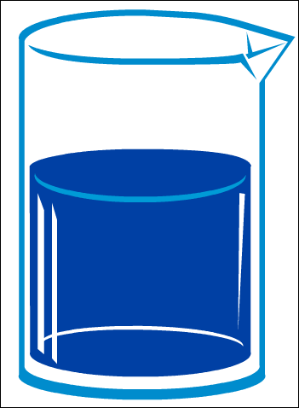
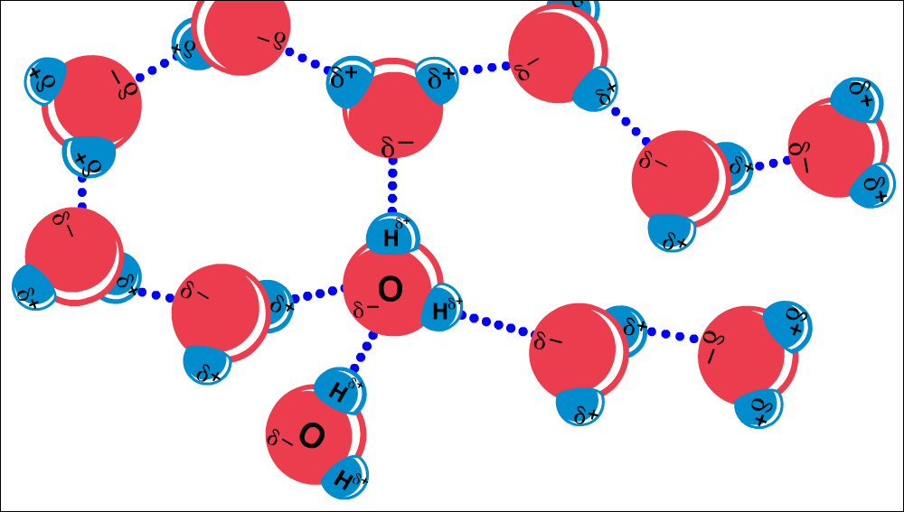
Water
Essential Questions: What’s so great about water?
SC.912.L.18.12: Discuss the special properties of water that contribute to Earth's suitability as an environment for life: cohesive behavior, ability to moderate temperature, expansion upon freezing, and versatility as a solvent.
Drs. Ann Williams & Heather Masonjones, Associate Professors of Biology, UT
Sawyer Masonjones – University of Florida undergraduate
Notes:
Image: http://www.public-domain-image.com/nature-landscapes-public-domain-images-pictures/waves-public-domain-images-pictures/waves-ocean.jpg.html

Slide 2
Additional Standards
SC.912.P.8.4 Explore the scientific theory of atoms (also known as atomic theory) by describing the structure of atoms in terms of protons, neutrons and electrons, and differentiate among these particles in terms of their mass, electrical charges and locations within the atom.
SC.912.P.8.5 Relate properties of atoms and their position in the periodic table to the arrangement of their electrons.
SC.912.P.8.8 Characterize types of chemical reactions, for example: redox, acid-base, synthesis, and single and double replacement reactions.
SC.912.P.8.11 Relate acidity and basicity to hydronium and hydroxyl ion concentration and pH.
SC.912.N.3.5 Describe the function of models in science, and identify the wide range of models used in science.

Slide 3
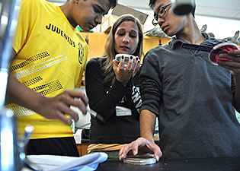
UT Bio Majors Head Back to High School to Teach

Slide 4
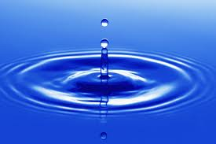
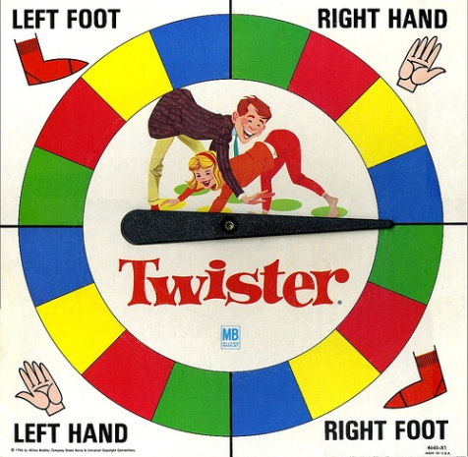
+
Water Kit
Molecular Twister
http://www.3dmoleculardesigns.com/

Slide 5
Objectives
*Description of the structure of water molecules
*Description of intra and inter molecular bonds of water and other molecules
*Discussion of the 4 unique properties of water making it crucial for life on earth
*Discussion and review of chemical bonding & electronegativity
Modeling & Questioning

Slide 6
Student Materials/Equipment
*3D Molecular Designs Water Kit –
(each kit includes 12 water molecules (24 red pieces & 24 white pieces), 1 sodium (smaller blue atom), 1 chloride (larger green atom), 1 ethane, and 1 hydroxyl group (an oxygen and hydrogen molecule - OH)
*NaCl Lattice Kit
*Molecular Twister Kit
*Activity sheet –
Water, Water Everywhere – But How Does it Sustain Life?
-Instructor version – includes answers to guided questions and addition resources and tips
-Student version – can be given directly out the to the students as an activity

Slide 7
The guided activity has been separated into 5 distinct sections to be used together or separately in a continuous activity or as separate activities when topics are introduced. Section 6 are challenge questions based on an environmental or health premise that can be used in conjunction with the presented activity as the teacher sees fit for their individual classroom.
Part 1 – Structure of Water – 3D Water Kit
Part 2 – Electronegativity & Bonding
A) Electronegativity – Molecular Twister Kit
B) Bonding – Molecular Twister Kit
C) Bonds within the water molecule – 3D Water Kit
Part 3 – Polarity of Water – 3D Water Kit
A) Bonds between water molecules
B) Bonds between water molecules & other molecules including
(a) ethane & ethanol
(b) NaCl
Part 4 – Unique Properties of Water – 3D Water Kit
A) Cohesion & Adhesion
B) High Specific Heat Capacity
C) Expansion Upon Freezing
D) Versatility as a Solvent
Part 5 – Role of pH Changes – Molecular Twister Kit
Part 6 – Challenge Questions – Molecular Twister Kit

Slide 8
Introduction – Water
Why is water so important to studying biology?
Life began in water
Living cells = 70-95% water
¾ of earth
3 physical states : ice, liquid, vapor

Slide 9
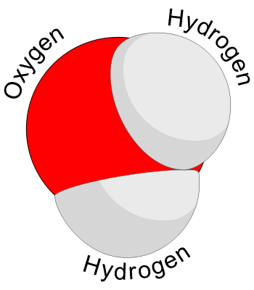
Part 1: Structure of Water
Assemble the 3D water molecules!
The water molecule
Made up of 2 H atoms joined to one O by a single covalent bond

Slide 10
Water Kit
Water Activity
Part 1: Activity Assemble a water molecule
http://www.3dmoleculardesigns.com/
Within your Group
Spend some time exploring the water kits by creating the water molecules
following Activity on Page 2-3 (Student version)
Also, use the flip cards to further explore how the
water kit can be used in your classroom

Slide 11
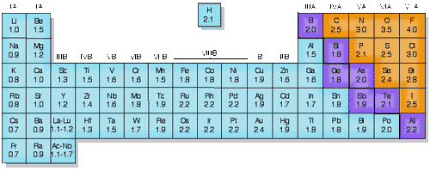
Part 2: Electronegativity & Bonding
Electronegativity=
Nonpolar covalent bond = equally shared electrons
-molecules of one element
-examples:
Polar covalent bond – unequally shared electrons
ENTable.gif faculty.sdmiramar.edu

Slide 12
Tug of war – With These Guys??
Who will win?
Connection to sharing versus stealing electrons
Covalent vs. Ionic bonds
gunnston.com

Slide 13
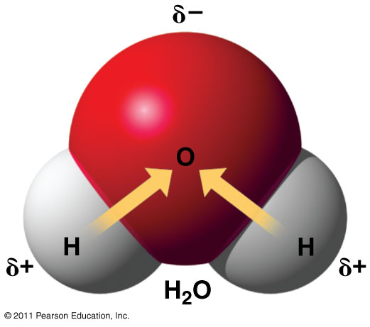
Electronegativity’s Connection to Water!
Fig. 2.13
Water Activity
Part 2: Electronegativity
Molecular Twister Kit

Slide 14
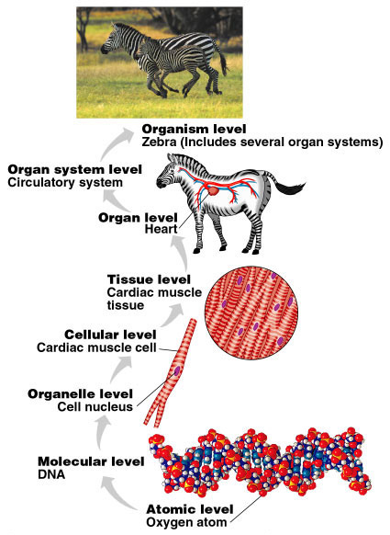
Part 2B) Let’s Review Atoms & Bonds
Atoms Elements Compounds

Slide 15
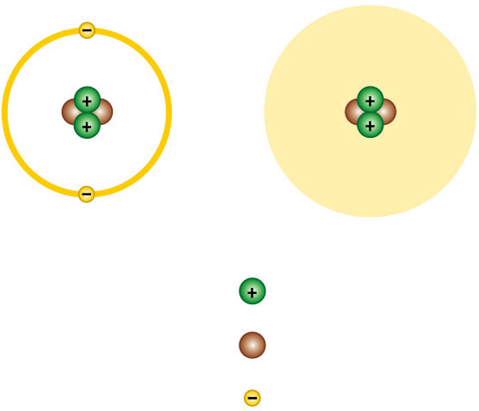
What is an Atom?
Nucleus
(a)
(b)
Cloud of negative
charge (2 electrons)
2
Protons
2
Neutrons
2
Electrons
Figure 2.5 - Helium

Slide 16
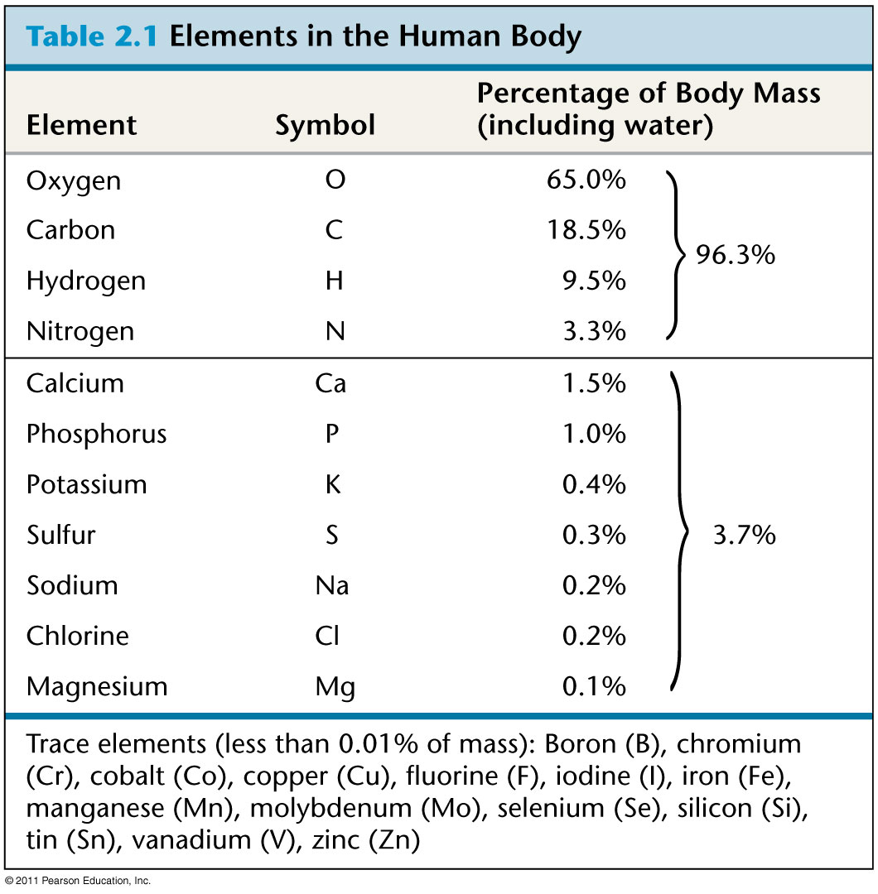
Atoms make up elements (92)
What is an element?

Slide 17
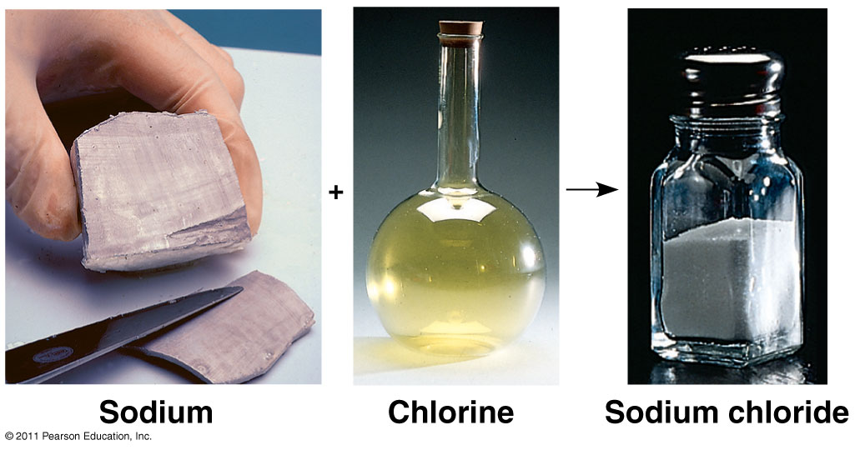
Elements make up Compounds in a fixed ratio
What is a compound?
NaCl

Slide 18
Atoms combine by chemical bonding to form molecules
Atoms interact by chemical bonding!
Types of bonds
Strong
- Covalent – sharing electrons
Weak
- Ionic – steals electron & then bond forms due to charges
– Hydrogen – unequal sharing of electrons & then bond forms due to charges

Slide 19
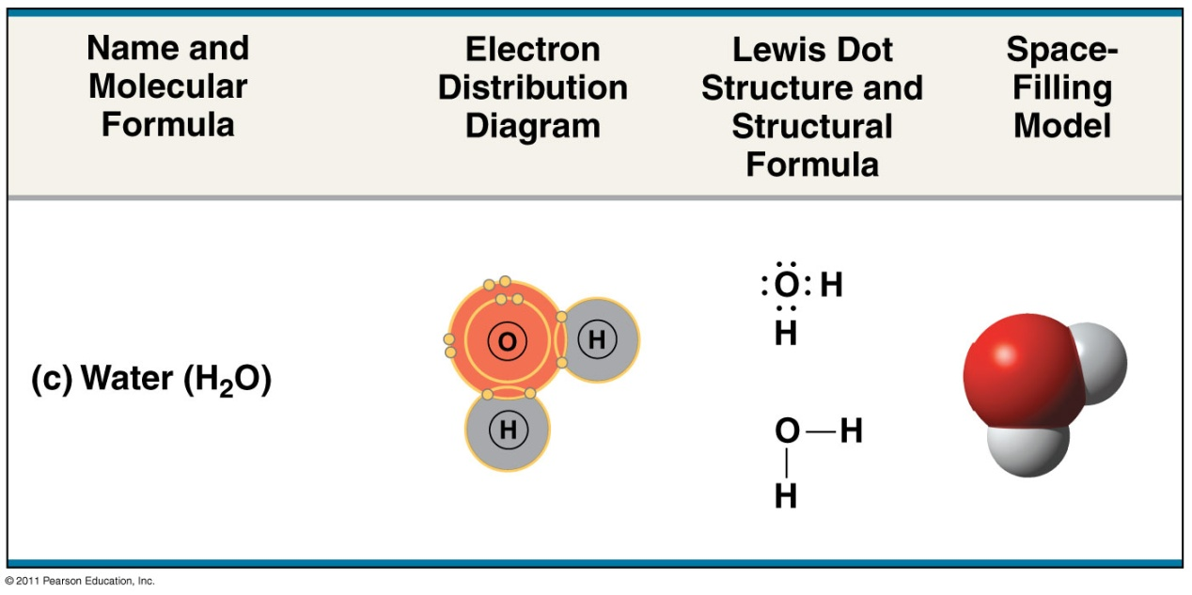
Covalent bonds can form between atoms of the same element or atoms of different elements.
Compounds=
H₂O
CH₄
Fig. 2.12c

Slide 20
Weak chemical bonds
Within a cell, weak, brief bonds between molecules are important to a variety of processes.
hydrogen bonds,
ionic bonds,

Slide 21
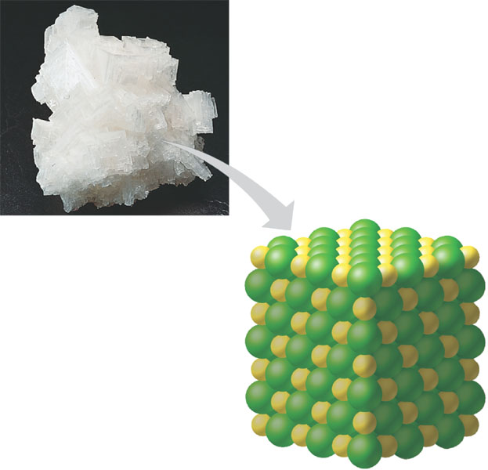
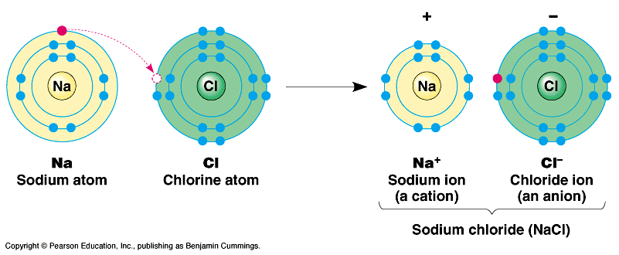
Ionic bonding=
-ion= charged
-anion= -
-cation= +
Opposites attract
Difference in electronegativity determine bond
Na⁺
Cl–
Figure 2.15
Fig. 2.14

Slide 22
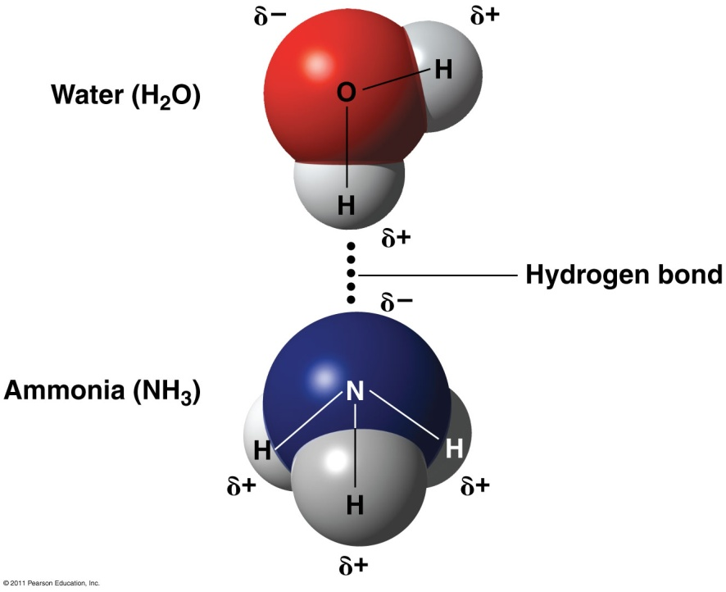
Hydrogen bonds = 2 electronegative atoms and hydrogen.
Weak
nitrogen or oxygen.
Results because hydrogen ion becomes electropositive
Example: water
Example: DNA
Fig. 2.16

Slide 23
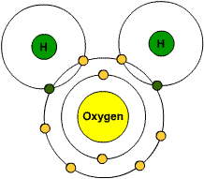
Covalent Bonds
Covalent bond: forms when 2 atoms share electrons
Water Activity
Parts 2B
Review Bonding
-Molecular Twister Kit

Slide 24
Water Activity
Parts 2C
Bonds within Water
-Water Kit
Let’s do the activity on Page 6 (Student Version)

Slide 25
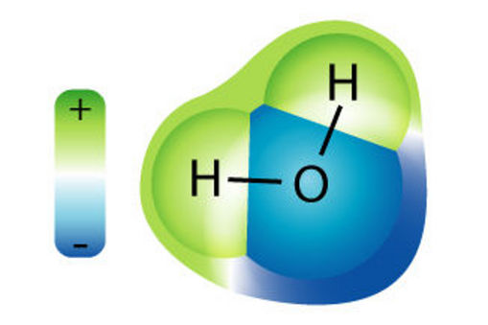
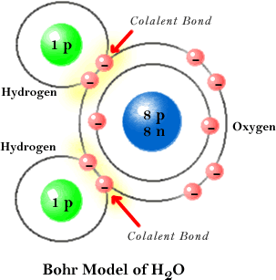
Water is a polar molecule
Part 3) Polarity of water molecules
Polar: unequal sharing of electrons
O pulls electron much more strongly than H
Makes O slightly (-), H slightly (+)
Opposite ends of molecule to have opposite charges
Makes water “sticky”

Slide 26
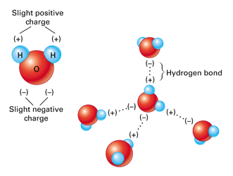
Hydrogen Bonds
Being polar, water molecules have a weak attraction to each other and form hydrogen bonds
Hydrogen bond: Chemical bond between 2 molecules formed by the attraction of a slightly (+) H atom to a slightly (-) atom
I’m responsible for most of water’s unique properties!
If water wasn’t polar I wouldn’t occur!

Slide 27
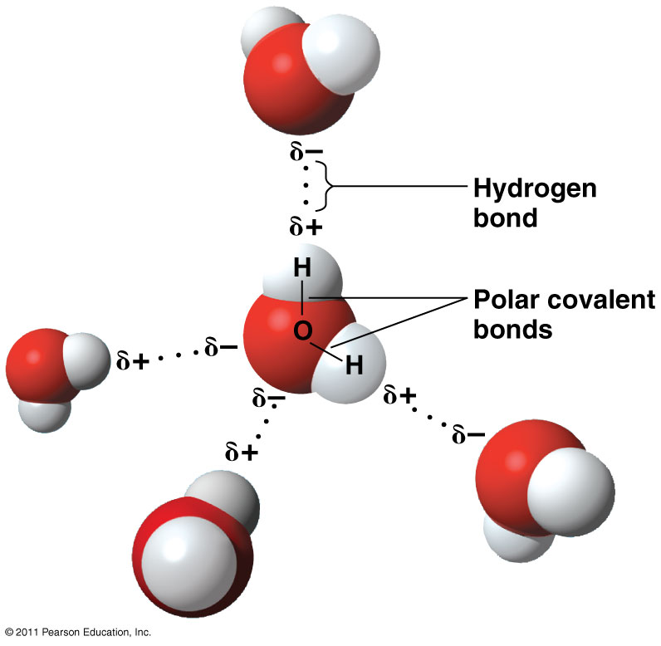
Polarity of water molecules and hydrogen bonding
Water is a polar molecule
Wide V shaped
Shared electrons,
not equally
Hydrogen bonding
Opposite charges by H of one atom to O of another
Maximum of 4 hydrogen bond
Fig. 3.2

Slide 28
Water Activity
Parts 3A:
Bonds Between Water Molecules
-Water Kit
Let’s do the activity on Page 8-10 (Student Version)

Slide 29
Water Activity
Parts 3B:
Bonds Between Water & Other Molecules
-Water Kit
Show Ethane & Ethanol
Show NaCl
on Page 10-13 (Student Version)

Slide 30
Which of the following makes up a water molecule?
White board review
1 atom of hydrogen and 1 atom of oxygen
1 atom of hydrogen and 2 atoms of oxygen
2 atoms of hydrogen and 1 atom of oxygen
2 atoms of hydrogen and 2 atoms of oxygen

Slide 31
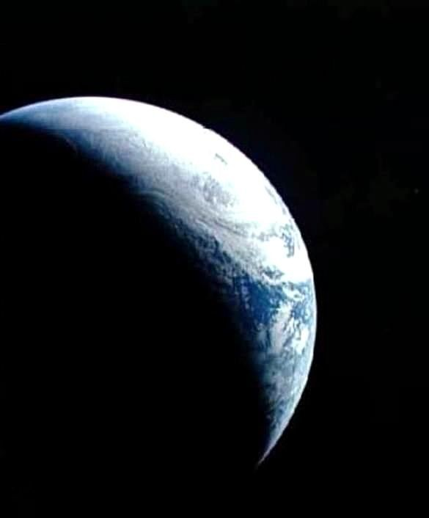
Part 4) Unique Properties of Water
Over 70% of earth’s surface is covered by water!
Water’s unique properties make life on Earth possible
A) Cohesion & Adhesion
Surface tension, capillary action
B) High Specific Heat Capacity
Ability to moderate
temperature
C) Solid/Expansion upon freezing
Ice floats
D) Versatility as a solvent
Dissolves many solutes
Notes:
Image: http://www.public-domain-image.com/space-public-domain-images-pictures/earth-from-outer-space.jpg.html

Slide 32
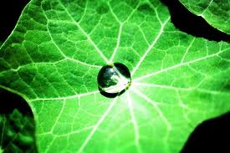
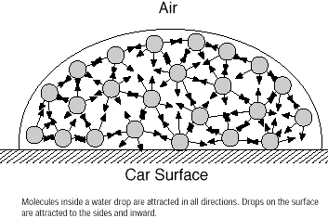
A) Cohesion
Water has many unusual properties b/c of its polar nature and ability to hydrogen bond
Cohesion: the tendency of molecules of the same kind to stick together
Water has strong cohesion
Creates surface tension
Ex. water bead

Slide 33
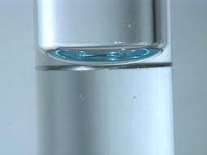
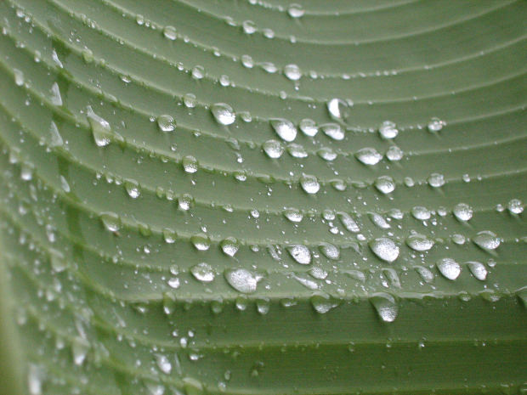
Adhesion
Adhesion: molecules are attracted to other molecules
Together with cohesion creates capillary action
Ex. Meniscus
Notes:
Image: http://www.morguefile.com/archive/display/603408

Slide 34
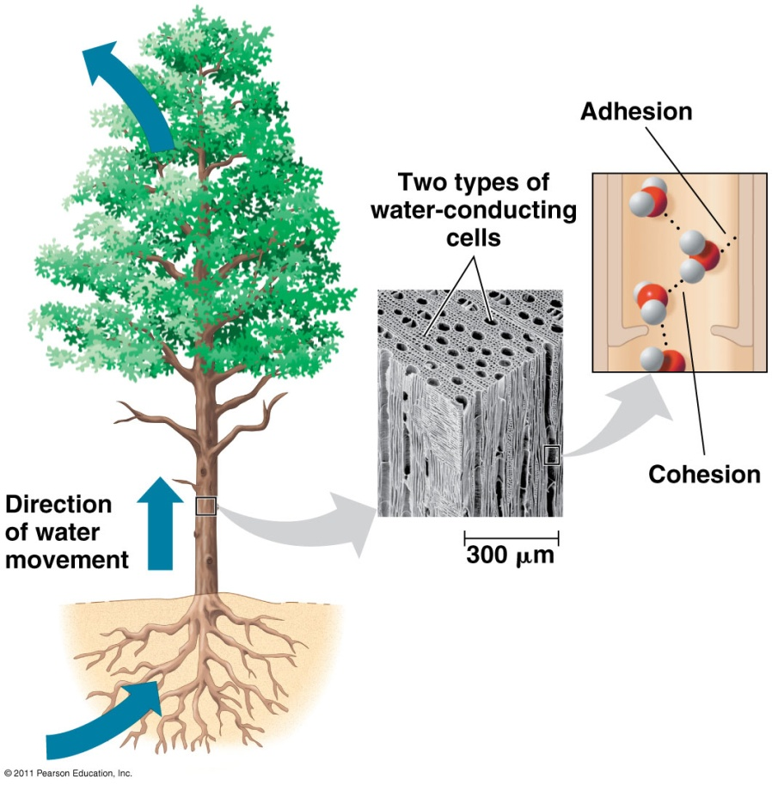
Cohesion - Organisms depend on the cohesion of water molecules
Cohesion=
Adhesion =
Hydrogen bonds
Cohesion important for water
transport in plants
Fig. 3.3

Slide 35
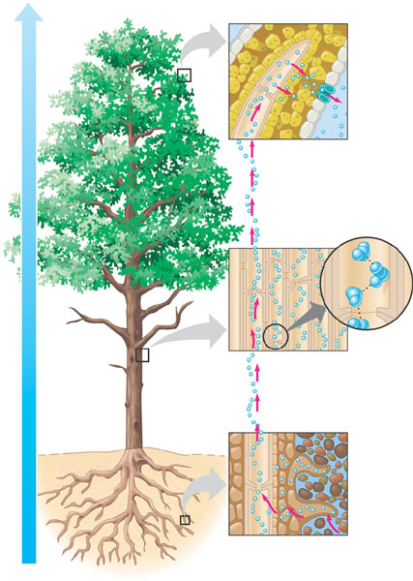
Transpiration Cohesion and Adhesion Together
Cohesion and adhesion help move water up from the roots of a plant.
Cohesion
H2O molecules sticking to each other forming a rope that is pulled out as water vapor “exhaled” through the leaves.
Adhesion
Water molecules stick to the walls of the xylem on the inside of the plant
Hydrogen bonds causing cohesion and adhesion!
Hydrogen Bonding!

Slide 36
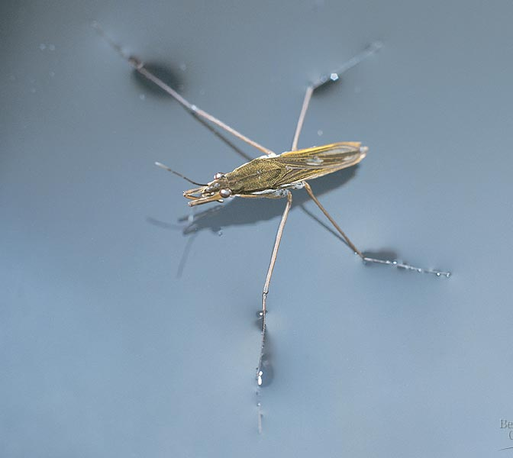
Surface tension=
Water greater than most
Air/water interface
Example:
Glass of water
Animals walking on water
Fig. 3.4

Slide 37
Water Activity
Parts 4A:
Properties of Water
Cohesion & Adhesion
Capillary Action
Walk on Water
-Water Kit
Perform both activities
on Page 14 (Student Version)
Perform activity on Page 16 (Student Version)

Slide 38
B) Temperature Moderation
High Specific Heat Capacity
Water can absorb lots of thermal energy without a large increase in its own temperature
Due to hydrogen bonding
Temperature is a measure of kinetic movement of molecules, “sticky” hydrogen bonds resist movement and therefore temperature increase.
Notes:
Image: http://www.trekearth.com/gallery/North_America/United_States/Midwest/Missouri/photo56022.htm

Slide 39
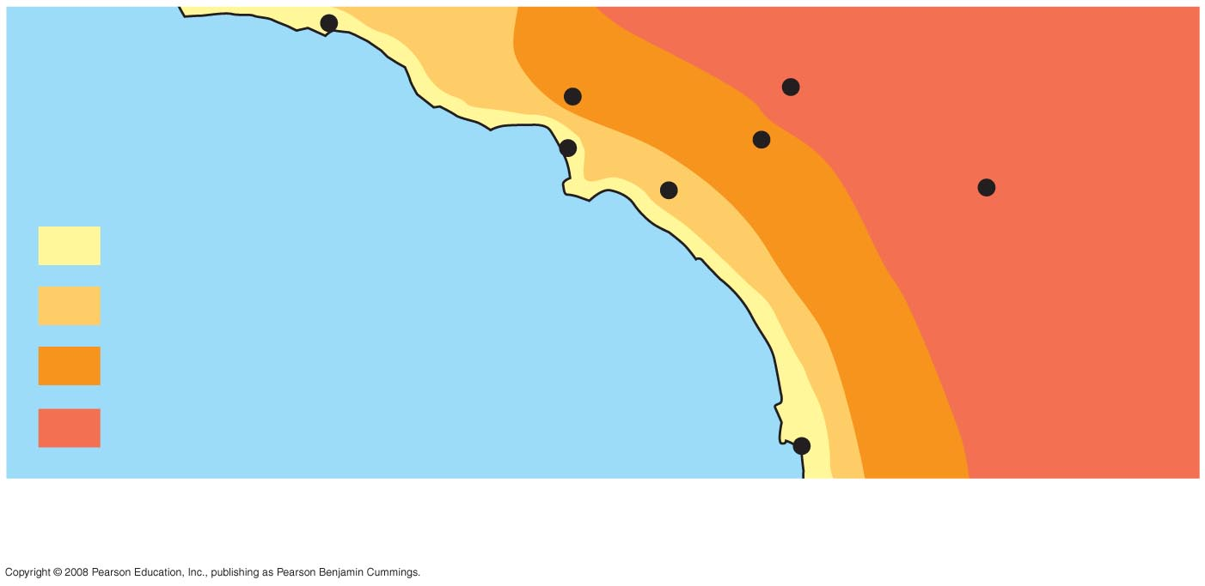
Temperature Moderation and High Specific Heat
Fig. 3-5
What do you notice here?
Burbank
90°
San Bernardino
100°
Santa Barbara 73°
Los Angeles
(Airport) 75°
Riverside 96°
Santa Ana
84°
Palm Springs
106°
70s (°F)
80s
Pacific Ocean
90s
100s
San Diego 72°
40 miles
Notes:
Figure 3.5 The effect of a large body of water on climate

Slide 40
How does water stabilize temperature
Specific heat = amn’t of heat needed for 1g of substance to change its temp by 1C.
1 cal/g/ºC. (unusually high)
Water resists changes in temperature because of hydrogen bonding
absorbed = break hydrogen bonds
released = hydrogen bonds form
Disrupt bonds not move molecules, so can resist temp changes.
Impact on environment
Keep temperature range suitable for life
Coastal have milder climates
Marine environment stable.
Impact on organisms (resist changes in internal temp).

Slide 41
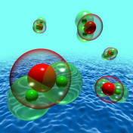
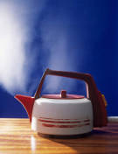
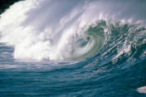
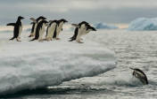
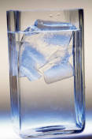
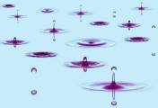
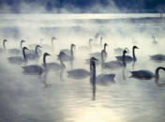
Phases of Water
Liquid: at room temperature
Solid: 0°C
Gas: 100° C

Slide 42
Water Activity
Parts 4B:
Properties of Water
High Specific Heat Capacity
Evaporation & Condensation
-Water Kit
Perform activity
on Page 19 (Student Version)

Slide 43
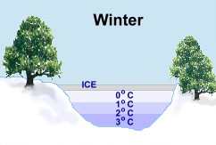
C) Less Dense as a Solid
Biological Importance: Ice (solid)
Ice expands upon freezing
Hydrogen bonds become less flexible and stabilize.
Less dense than liquid = floats
Oceans and lakes don’t freeze solid
Insulates aquatic ecosystems during winter
Allows life to survive winter
Notes:
Image: http://www.worsleyschool.net/science/files/water/density.html

Slide 44
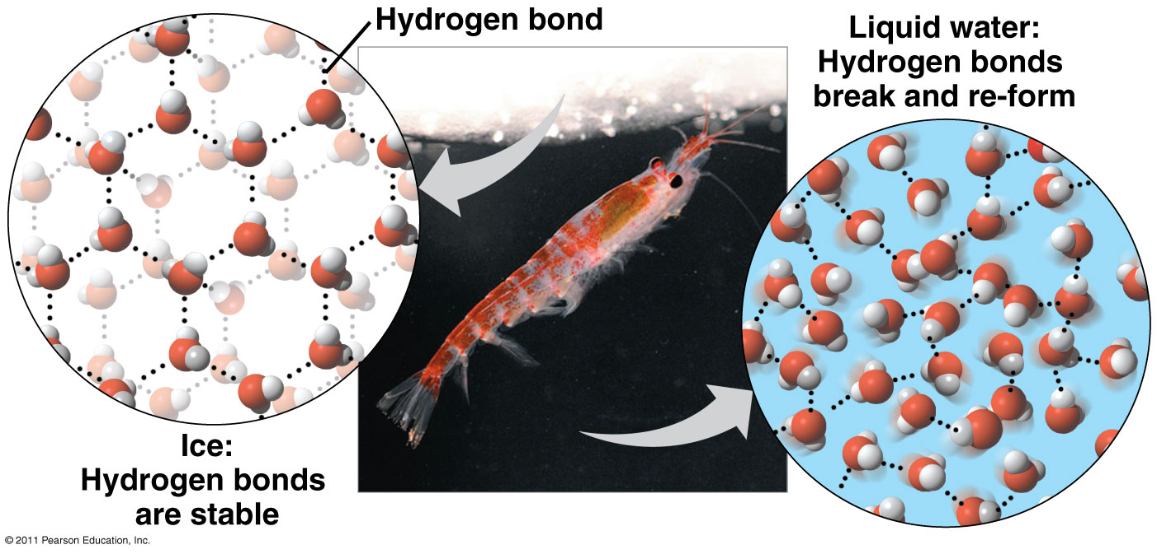
C) Water as an insulator
Water is less dense as a solid than as a liquid.
densest at 4ºC
10% less dense when ice
molecules are no longer moving
Bonded to a maximum of 4 partners
Fig. 3.6

Slide 45
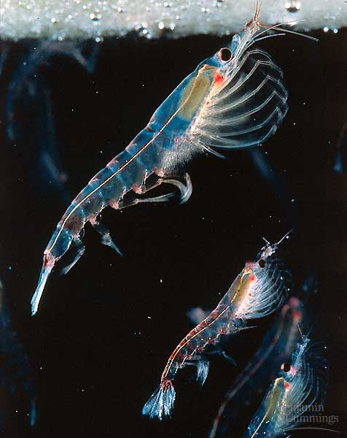
This oddity has important consequences for life – Why?
Prevents water from freezing solid.
Forms on surface.
Insulates water below
Euphausid shrimp, beneath
the antarctic ice

Slide 46
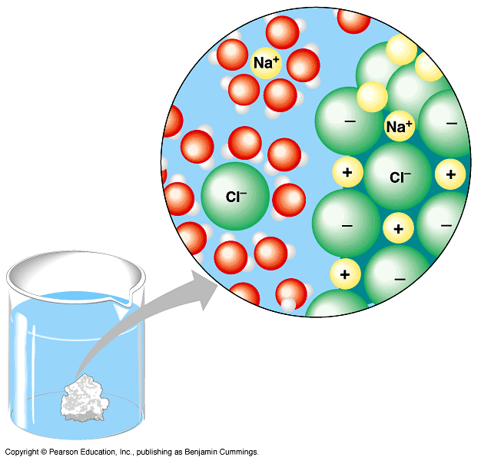
D) Universal Solvent
-
-
-
-
-
Water is an important solvent forming many solutions many solutions.
This is because water is polar
Solvent: substance that dissolves other substances
When water is the solvent, the solution is called an aqueous solution.
+
+
+
+
+
+
+
+
+
+
What do you notice about the water molecules?

Slide 47
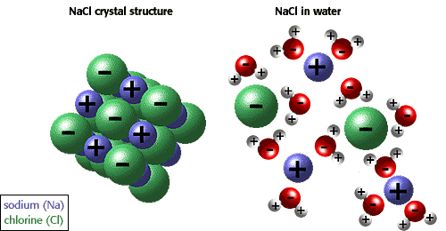
http://www.biology.arizona.edu/biochemistry/tutorials/chemistry/page3.html

Slide 48
Universal Solvent
Very important property!
Most important biological reactions take place in aqueous solutions.
Digestion
Saliva is a solution containing water, proteins and salts
Circulation
Blood is a solution containing water, gases, proteins and many molecules necessary for life!
Notes:
Image: baileybio.com

Slide 49
Water Activity
Parts 4D:
Properties of Water
Versatility as a Solvent
-Water Kit & NaCl Lattice Kit
Perform activity
on Page 20 (Student Version)

Slide 50
Which of the following does not contribute to transpiration (water moving up the xylem of a plant)?
White board review
Cohesion
Specific heat capacity
Capillary action
Adhesion

Slide 51
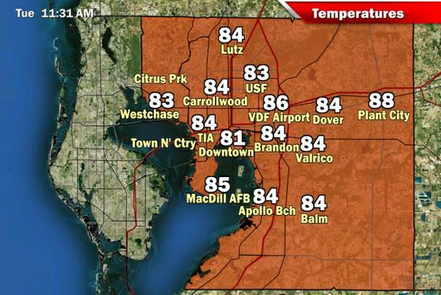
With which property of water would you explain the cooler summer temperatures along the coast and the higher inland temperatures?
White board review
Cohesive behavior
High specific heat capacity
Expansion upon freezing
Versatility as a solvent

Slide 52
The polarity of the water molecule is responsible for
White board review
Hydrogen bonding
Water’s versatility as a solvent
Cohesion
The low density of ice
All of the above
None of the above

Slide 53
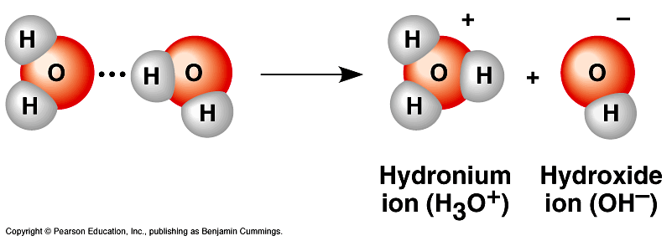
Water….behavior in solution
Part 5) How does water relate to pH?
a hydrogen atom shared by two water molecules shifts.
A hydrogen ion (H⁺) and a hydroxide ion (OH⁻).
hydronium ion (H₃O⁺).
Dissociation = ionization of H₂O
H₂O <=> H⁺ + OH⁻
but water still most common molecule

Slide 54
Water & pH
Extra
proton
Extra
electron
H⁺
H₂O <=> H⁺ + OH⁻
H₂O > H⁺ + OH⁻
equilibrium
H₂O > H⁺ + OH⁻
HCl – acidic solution
HCl -> H⁺ + Cl⁻
Acids
Bases
H₂O H⁺ + OH⁻
NH₃ + H⁺ <=> NH₄⁺
NaOH -> Na⁺ + OH⁻
OH⁻ + H⁺ -> H₂O

Slide 55
Biological systems are sensitive to changes in pH
Acid = increases H⁺ in solution
HCl -> H⁺ + Cl⁻
Or decreases OH⁻ by formation of H₂O
Base = reduces the H⁺ concentration
Some bases reduce H⁺ directly.
NH₃ + H⁺ <=> NH₄⁺
Some bases reduce H⁺ indirectly
NaOH -> Na⁺ + OH⁻ OH⁻ + H⁺ -> H₂O

Slide 56
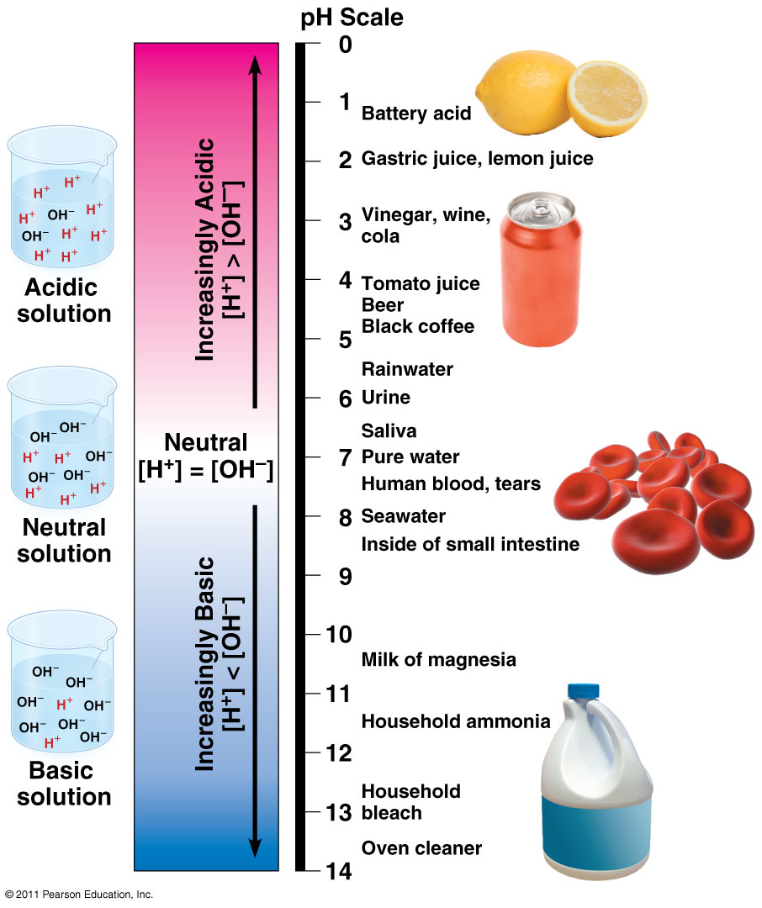
Values for pH decline as [H⁺] increases.
Slight change in pH represents large change in [H⁺].
Copyright © 2002 Pearson Education, Inc., publishing as Benjamin Cummings
Fig. 3.10

Slide 57
Part 6: Challenge Questions
Environmentally Related
Health Related

Slide 58
Molecular Twister
Molecular Twister Kit
Part 2A: Electronegativity
Part 2B: Bonding
Part 5: pH
Part 6: Challenge Questions
Discussion of Kit
Demonstration of Kit
Introduction to Activities

